Slide 1
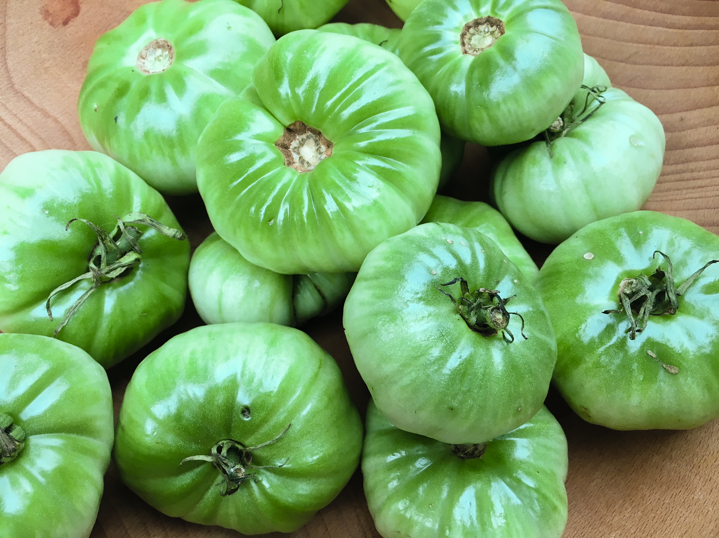
The Tinkerer’s
Spiced Green Tomato Chutney
September 2018

